Slide 1
RocksDB Festival
Supported by IITP, StarLab.
July 19, 2021
송인호, 한예진
inhoinno@dankook.ac.kr , hbb97225@naver.com
TeamName : 멘탈모델을 만들고 싶어요

Slide 2
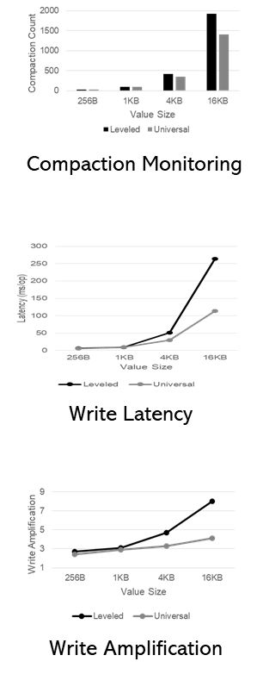
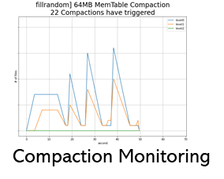
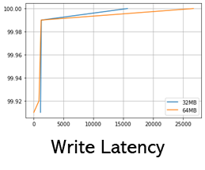
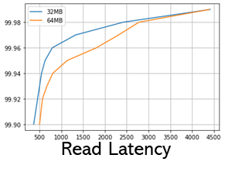
Contents
Last Week
컴팩션에 영향을 미치는 녀석들 #1 KV Size
컴팩션에 영향을 미치는 녀석들 #2 SST Size
This Week
Mental Model
Alleviating [PROBLEMS] of Level Compaction by [Method] in Universal Compaction
Leveled vs Universal Compaction Comparison
Throughput
Write Amplification
Latency distribution + # of Compactions
Read/Space Amplification
2

Slide 3
Compaction Style
Leveled Compaction, Universal Compaction
Sorted Level vs Sorted Run
Example of LeveledCompaction
Example of Universal Compaction
level
level
0
1
2
0
1
2
0
1
2
7
insert 13
0
1
2
0
1
2
0
1
2
7
insert 13
1 3
10 19
Flush &
merge
3 19
1 10
2 4 8 12 15 18
2 4 8 12 15 18
flush
move
merge &
move
1 3
7 10 13 19
3 19
1 10
7 13
2 4 8 12 15 18
2 4 8 12 15 18
merge
1 2 3 4 7 8
10 12 13 15 18 19
2 4 8 12 15 18
1 3 7 10 13 19

Slide 4

Mental Model
RocksDB
레벨 컴팩션의 문제점을
유니버셜 컴팩션의 “__“
으로
완화할 수 있다

Slide 5
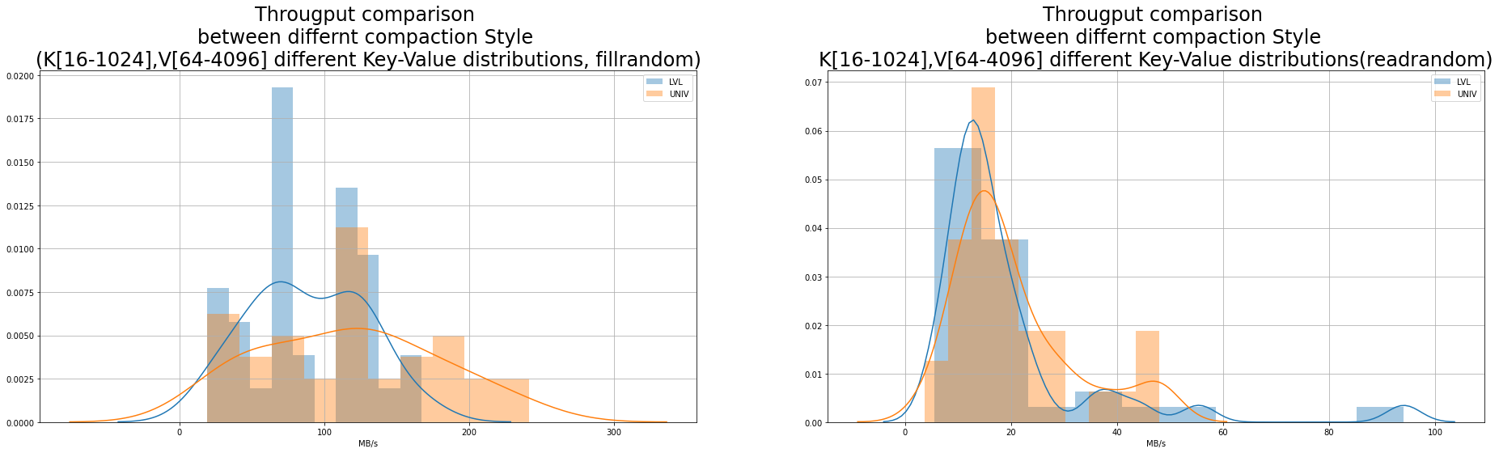
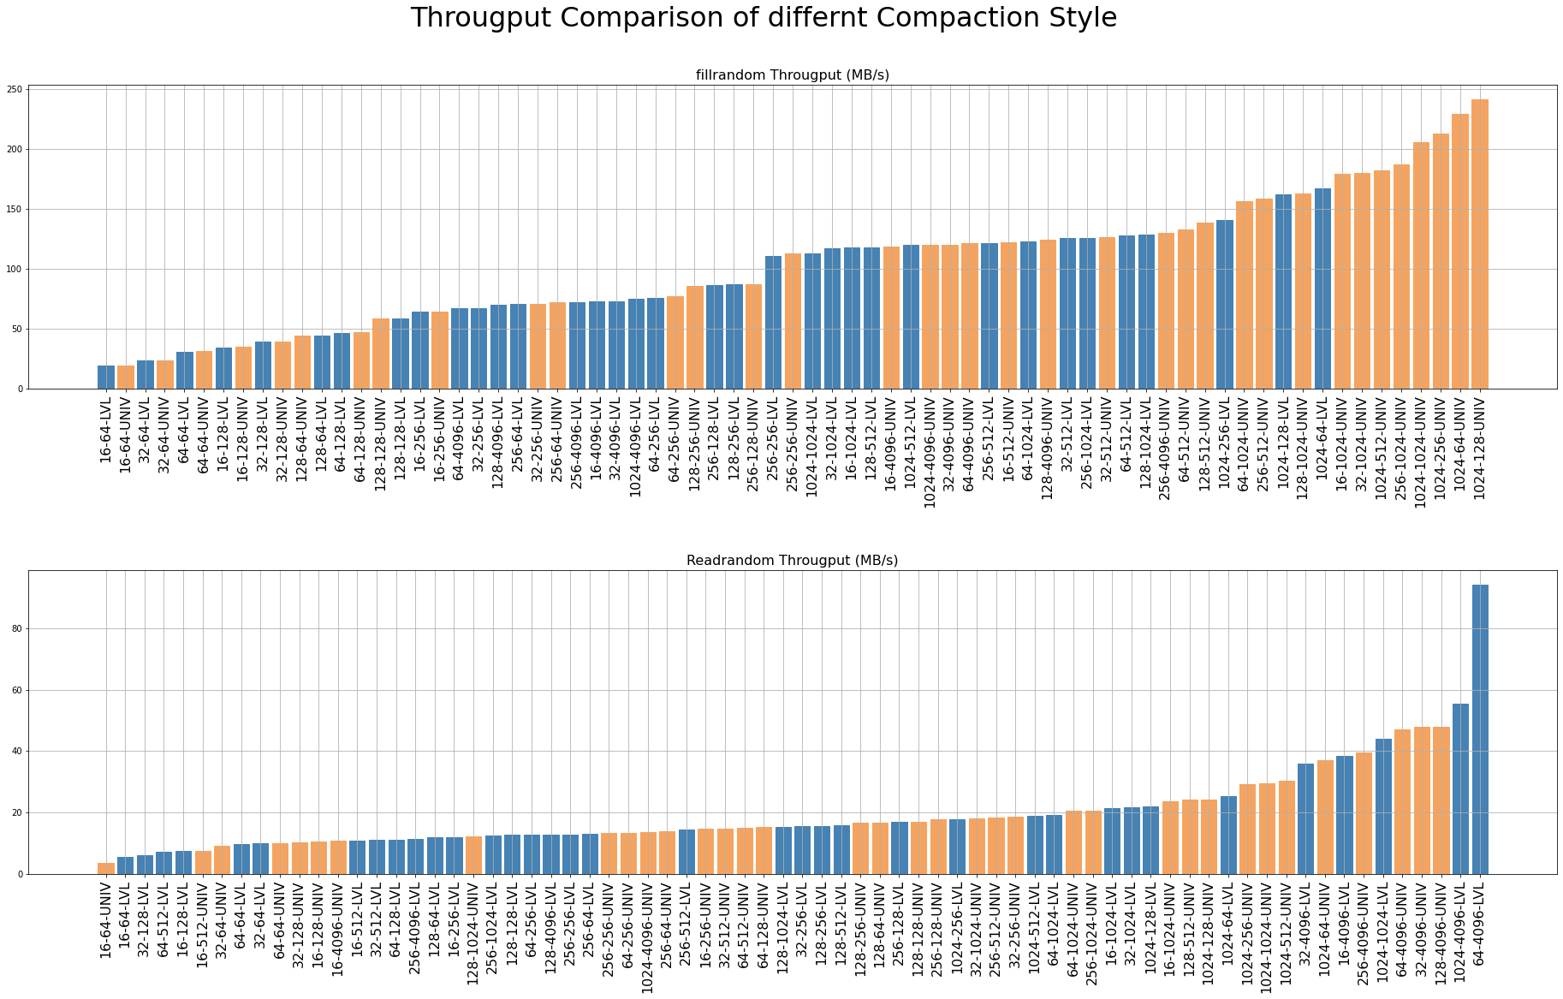
LVL vs Univ Throughput Comparison
Fillrandom
Key [16, 32, 64, 128, 256, 1024]
Value [64, 128, 256, 512, 1024, 4096]
Entries 500 0000
Storage Samsung 1TB 860 Pro
File System Ext4
CPU Intel(R) Core(TM) i7-10700K CPU @ 3.80GHz
LVL Compaction
Univ Compaction
Left is better
LVL Compaction
Univ Compaction
MB/s

Slide 6
LVL vs Univ Throughput Comparison
Readrandom
--use_existing_db
Key [16, 32, 64, 128, 256, 1024]
Value [64, 128, 256, 512, 1024, 4096]
Entries 500 0000
Storage Samsung 1TB 860 Pro
File System Ext4
CPU Intel(R) Core(TM) i7-10700K CPU @ 3.80GHz
LVL Compaction
Univ Compaction
Left is better
LVL Compaction
Univ Compaction
hard to define
what it is…
MB/s

Slide 7
LVL vs Univ Throughput Comparison
Optimal Key Size
Readrandom
--use_existing_db
Key [16, 32, 64, 128, 256, 1024]
Value [64, 128, 256, 512, 1024, 4096]
Entries 500 0000
Storage Samsung 1TB 860 Pro
File System Ext4
CPU Intel(R) Core(TM) i7-10700K CPU @ 3.80GHz
LVL Compaction
Univ Compaction
1/time
Left is better
MB/s
LVL Compaction
Univ Compaction
MB/s
☞ 마치 Value Size에 맞는 Optimal Key Size가 있는 것 처럼 보인다

Slide 8
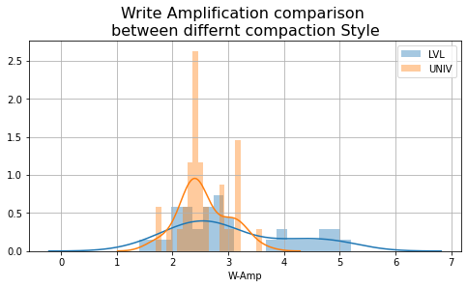
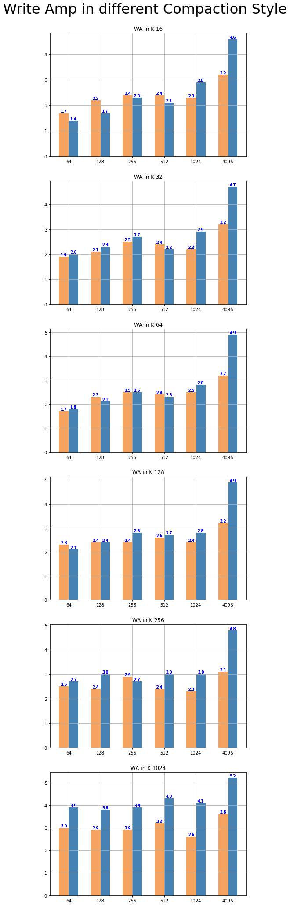
LVL vs Univ WAF Comparison
LVL Compaction
Univ Compaction
LVL Compaction
Univ Compaction
LVL Compaction
Univ Compaction

Slide 9
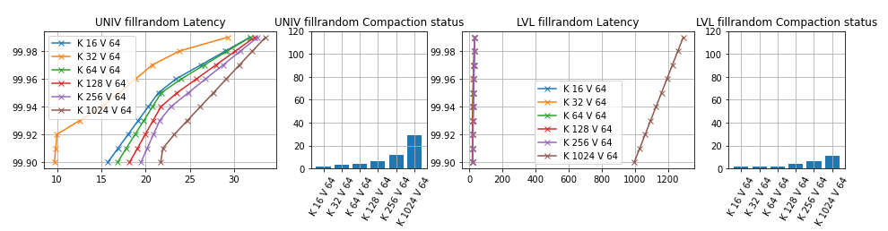
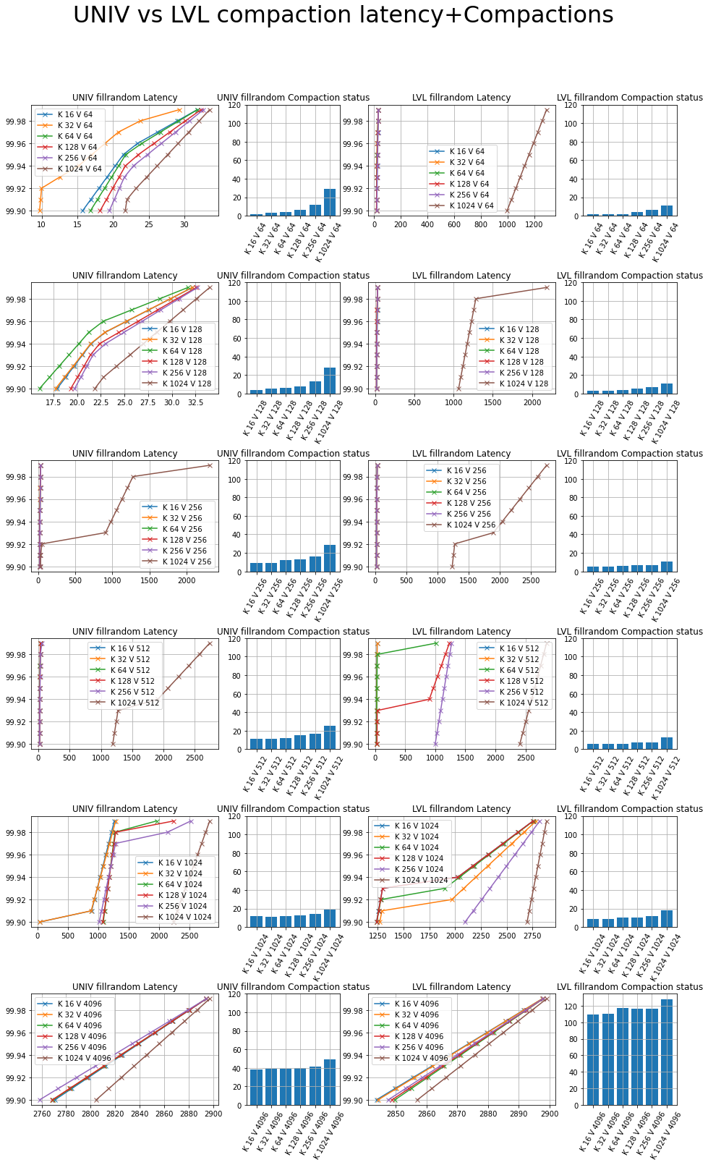
LVL vs Univ # of Compactions , latency Comparison
Fillrandom

Slide 10
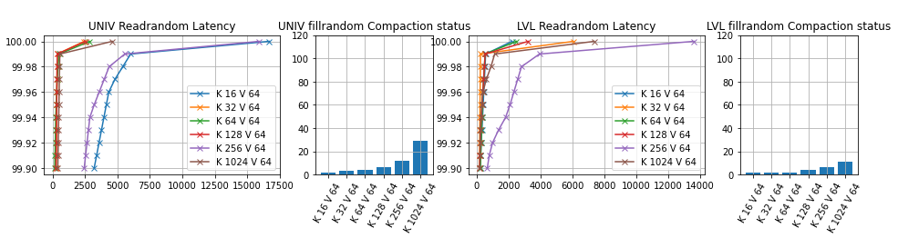
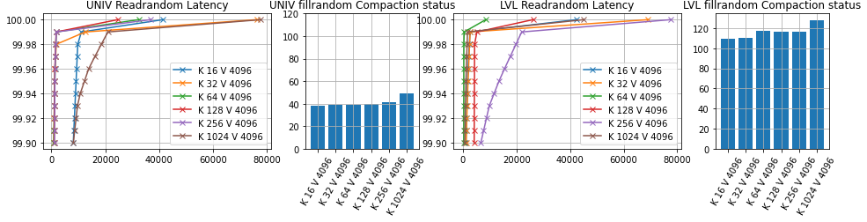
LVL vs Univ # of Compactions / latency Comparison
Readrandom

Slide 11

Issue on Last week
Throughput(KOPS)
Throughput(MB/s)
☞ 한 쪽은 OPS, 한 쪽은 MB/s 임.
즉, KV Size가 늘어날 수록 MB/s는 늘어나고, OPS는 줄어들게 됨

Slide 12
Next Week
Mental Model
Leveled vs Universal Compaction 관련 논문 조사
Hybrid Compaction 고민
Leveled vs Universal Compaction Comparison
Space Amplification 측정
Read Amplification 측정

Slide 13
Discussion

Slide 14
Appendix

Slide 15
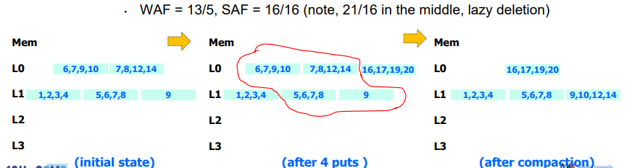
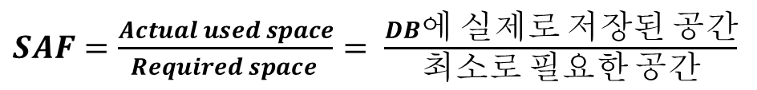
How to estimate Space Amplification Factor?
$SAF=\frac{Actual used space}{Required space }$ $= \frac{DB에 실제로 저장된 공간}{최소로 필요한 공간}$
☞ Not so simple
Jongmoo Choi, Key-Value Store: Database for Unstructured Bigdata (Focusing on RocksDB), 12th CSMS 융합〮스마트미디어 시스템 워크샵
☞ 중첩된 KV 를 고려하지 않아야함
☞ ☞ 따라서, (바라건대,) Sequential pattern 으로 쓰인 Size를 $′최소로 필요한 공간^{′}$ 으로 두고 구할 예정.
☞ Comment Plz

Slide 16
Last Week

Slide 17
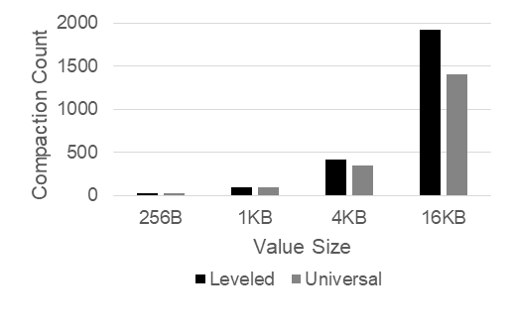
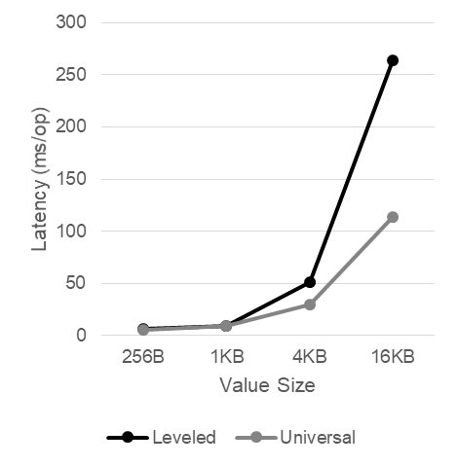
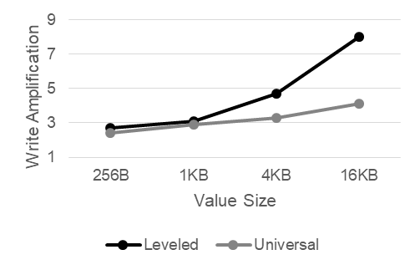
Compaction에 영향을 미치는 녀석들
#1 KV-Size
Various Key Size
Key: 16B, 32B, 64B, 128B
Value: 8K
fillrandom, readrandom, range query, 5000000
Leveled Compaction vs. Universal Compaction
Write Amplification
Various Value Size
Key: 16B
Value: 256B, 1KB, 4KB, 16KB
fillrandom, readrandom, range query, 5000000
Leveled Compaction vs. Universal Compaction
Write Amplification
+YCSB Workload, compare Read/Space Amplification
Compaction Monitoring
Write Latency
Write Amplification

Slide 18
RocksDB Festival
RocksDB::Compaction
Trial#3 Compaction on various Key size (random write)
Throughput
Compaction
Latency
WAF
18

Slide 19
RocksDB Festival
RocksDB::Compaction
Trial#4 Compaction on various Value size (random write)
Throughput
Compaction
Latency
WAF
19

Slide 20
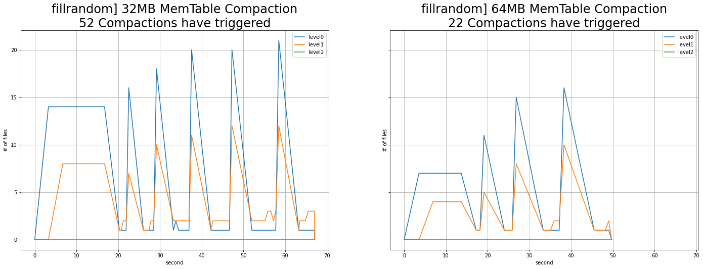
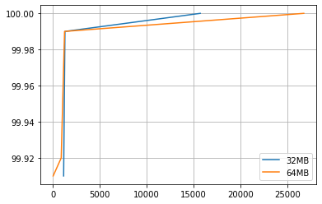
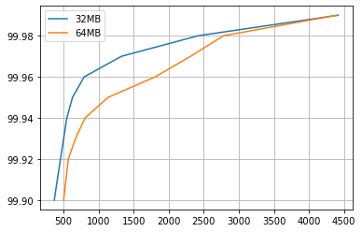
Compaction에 영향을 미치는 녀석들
#2 MemTable, SSTable
Various MemTable + Various SST
64MB, 32MB
fillrandom, readrandom, 16-512, 10000000
Various MemTable + 64MB SST
64MB, 32MB, 16MB, 8MB, 4MB, 2MB
fillrandom, readrandom, 16-512, 10000000
Compaction Monitoring
Write Latency
Read Latency

Slide 21
RocksDB Festival
Compaction::SSTable
Trial#1 Compaction on MemTable size&Target File Size (32MB vs 64MB)
☞
21

Slide 22
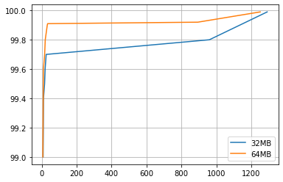
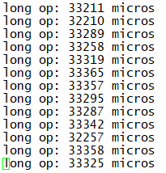
RocksDB Festival
Compaction::SSTable
Trial#1 Compaction on MemTable size&Target File Size (32MB vs 64MB)
fillrandom] Write Latency (99%)
readrandom] Read Latency (99%)
☞ Read/Write latency Trade-off on MemTable Size
22

Slide 23
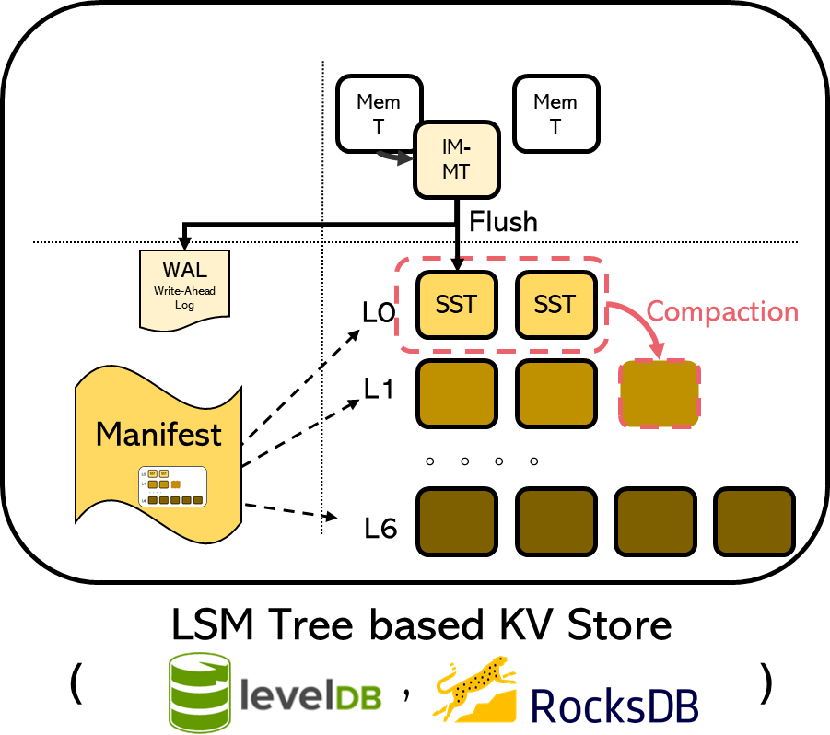
RocksDB Festival
Compaction::SSTable
Trial#2 Compaction on MemTable size, but Target File Size 64MB (MemT=[2,4,8,16,32,64]MB, SST_Level1 = 64MB)
Mem
Table
L0
SST
2MB
~
64MB
L1
SST
64MB
☞
23

Slide 24
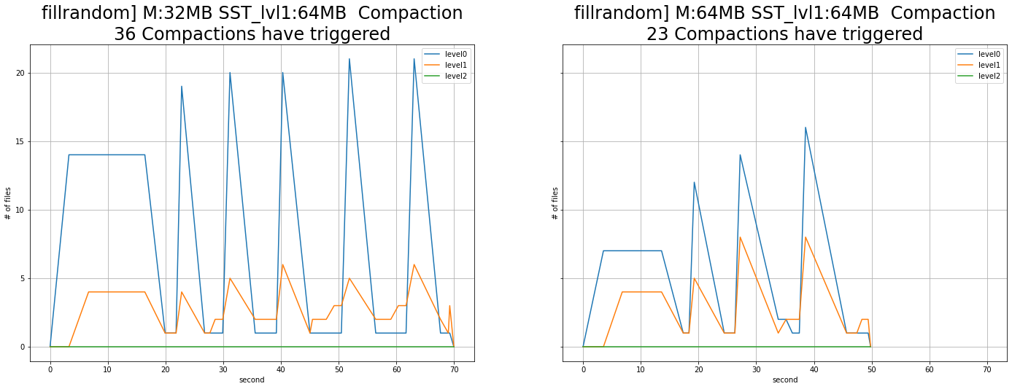
RocksDB Festival
Compaction::SSTable
Trial#2 Compaction on MemTable size, but Target File Size 64MB (MemT=[2,4,8,16,32,64]MB, SST_Level1 = 64MB)
☞ No difference between previous experiment
24

Slide 25
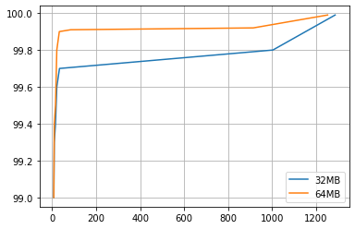
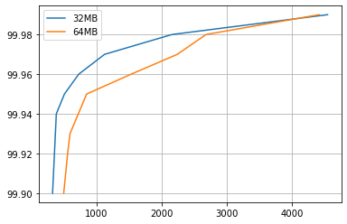
RocksDB Festival
Compaction::SSTable
Trial#2 Compaction on MemTable size&Target File Size (32MB vs 64MB)
fillrandom] Write Latency (99%)
readrandom] Read Latency (99%)
☞ No difference between previous experiment
25

Slide 26
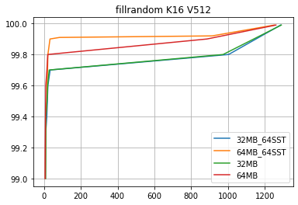
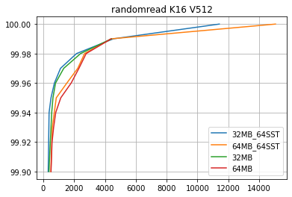

RocksDB Festival
Compaction::SSTable
Trial#1 vs Trial#2
fillrandom] Write Latency (99%)
readrandom] Read Latency (99%)
☞ ..?
26

